Slide 1





AUTONOMOUS CAR
NTI - ROUND 6 - GROUP 4
TEAM A

Slide 2
OUR TEAM
Designed, Developed, and Implemented
Ola Mohamed
Aya Ali
Fatma Abdelrhem
Fatma Mosaad
Elaf Mohamed
Mostafa Mohamed
Mohamed Saad

Slide 3
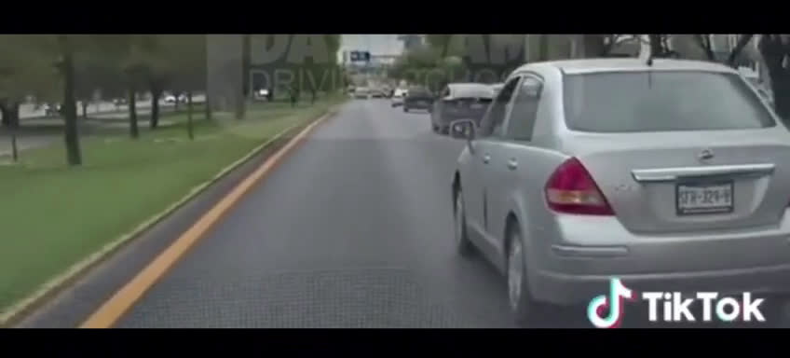

Slide 4
ADAS

Slide 5

Project Overview

Slide 6
FEATURES
Lane Detection
Auto Parking
Collision Avoidance
Adaptive Cruise Control

Slide 7
Hardware Components

Slide 8

IR
Dc Motor
(Steering Control)
Ultrasonic
Dc Motor
(Motion Control)

Slide 9
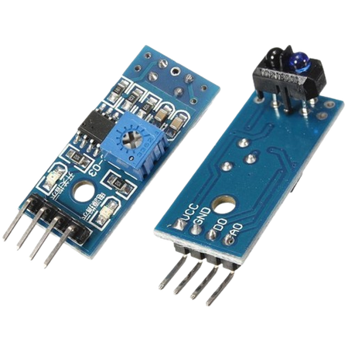
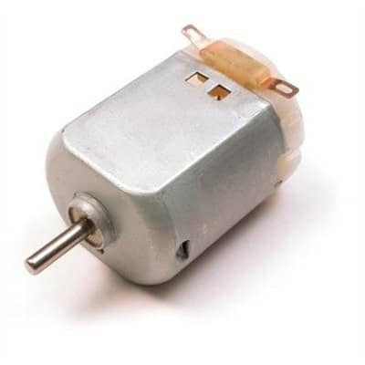
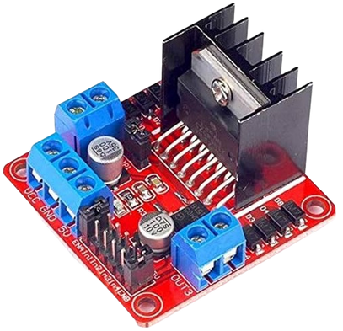
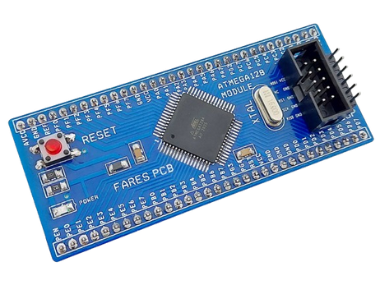
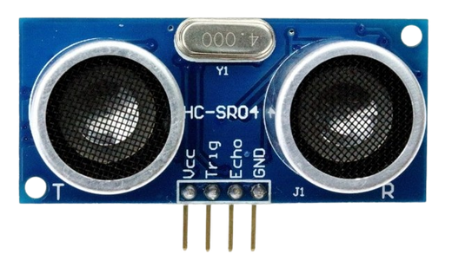

IR Sensor
Motor Driver
Dc Motor
Atmega128
Ultrasonic Sensor
Car Kit

Slide 10
Software Architecture

Slide 11

APP
RTOS
HAL
MCAL
Microcontroller

Slide 12
Lane Detect
Auto Parking
Adaptive
Collision Avoid
RTOS
Ultrasonic
Dc Motor
IR
DIO
Timers
Interrupts
Atmega Alternative Function
Atmega Registers

Slide 13
RTOS

Slide 14
Start
Adaptive Cruise
Lane Detect
Auto Parking
Ultrasonic
Avoid Collision
Check IR 1,2
Read Ultra 1
Read < Distance
Read Distance
Read
Ultra 2
Take Action
Adjust car speed
Stop Car
Read Ultra 3

Slide 15
Auto Parking
Ultrasonic
Suspend other tasks
Read Ultra 1
Distance available?
Read
Ultra 2
Parking done?
Start parking
Read Ultra 3

Slide 16
Lane Detection

Slide 17
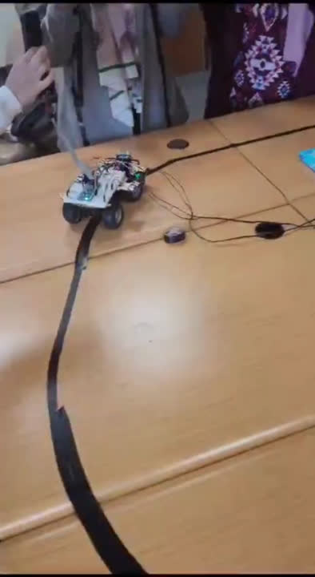

Slide 18
Auto Parking

Slide 19
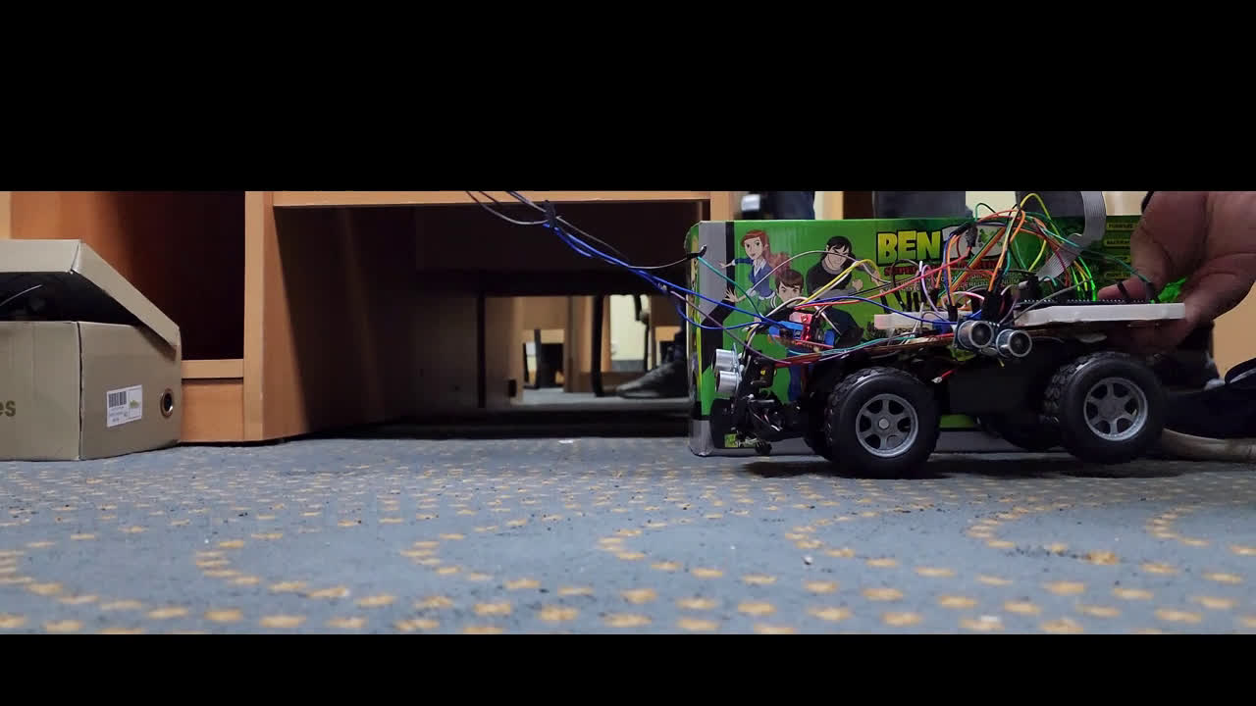

Slide 20
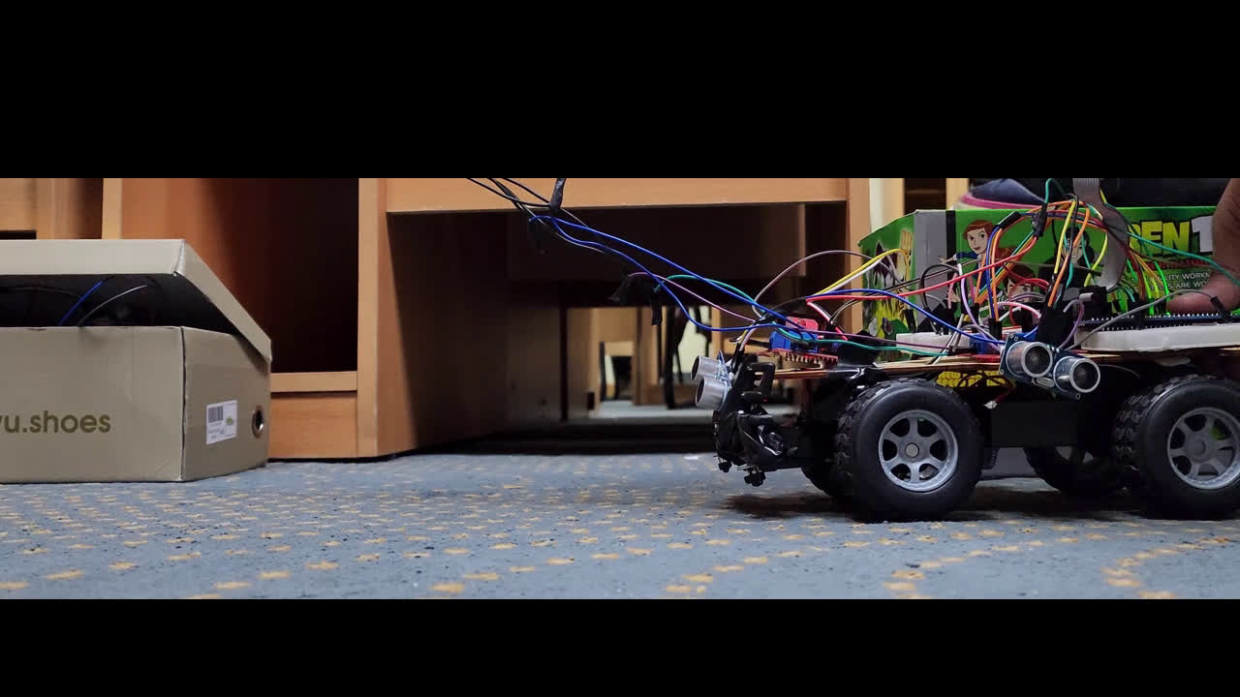

Slide 21
Collision Avoidance

Slide 22
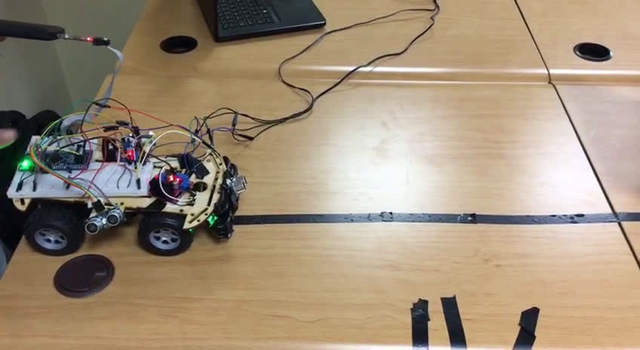

Slide 23

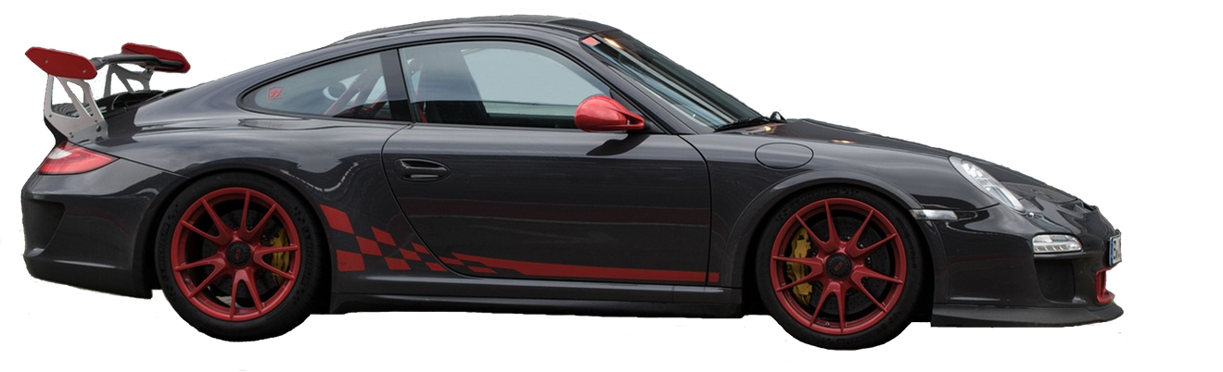
THANK'S FOR WATCHING

